Slide 1


Working with Cinematic Techniques

Slide 2
Film Analysis
Much like how a writer uses stylistic devices to achieve specific effects in their writing, directors use cinematic techniques in their films for specific purposes.
In order to analyse a film through critical viewing like you do a text in critical reading, you must understand the tools that filmmakers use to create their visual masterpieces.

Slide 3

SHOTS and FRAMING, CAMERA ANGLES and CAMERA MOVEMENTS
All compare to how a writer uses POINT OF VIEW
Shot: a single piece of film uninterrupted by cuts
Of course, different shot types, angles and movements achieve different effects

Slide 4
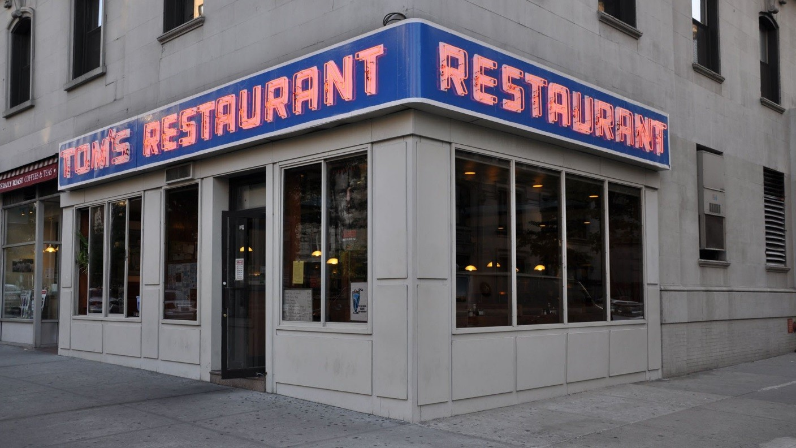
ESTABLISHING SHOT - Often a long shot or a series of shots that sets the scene; is used to establish setting and to show transitions between locations
From the TV Show “Seinfeld”

Slide 5
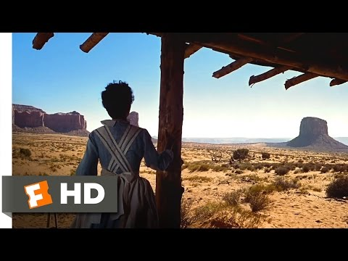

Slide 6
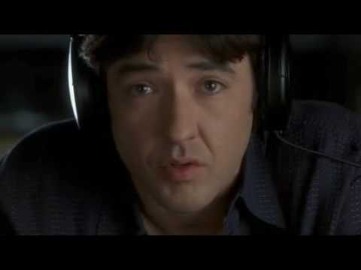

Slide 7
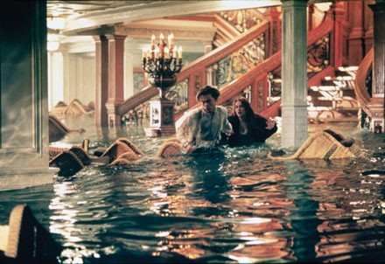
LONG SHOT – a shot from some distance. If filming a person, the full body is shown. It may show the isolation or vulnerability of the character
From the movie “Titanic”

Slide 8
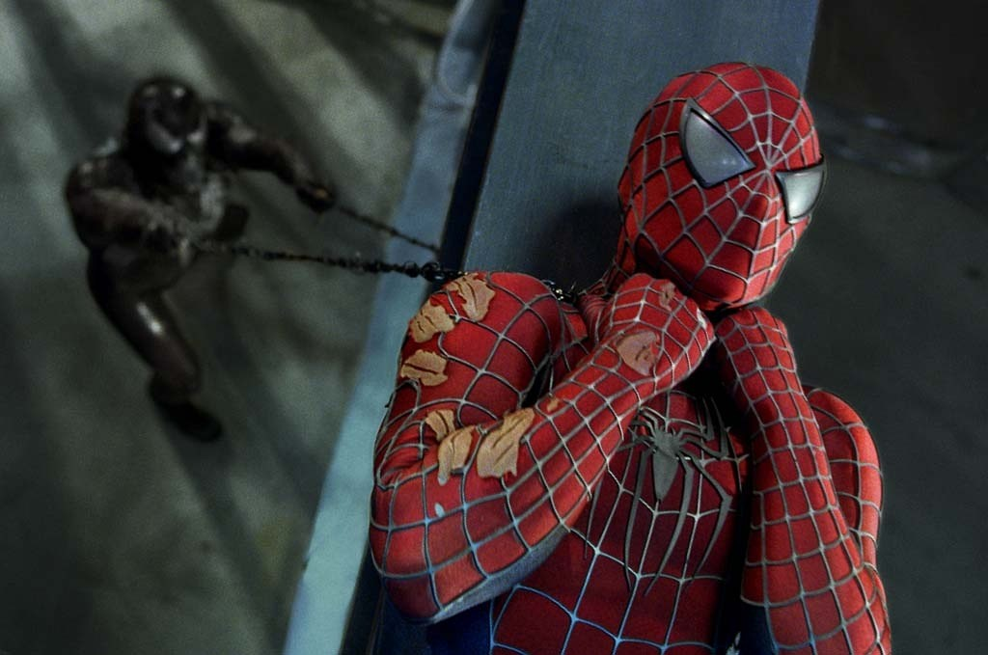
MEDIUM SHOT – the most common shot. The camera seems to be a medium distance from the object being filmed. A medium shot shows the person from the waist up. The effect is to ground the story.
From the movie “Spiderman 2”

Slide 9
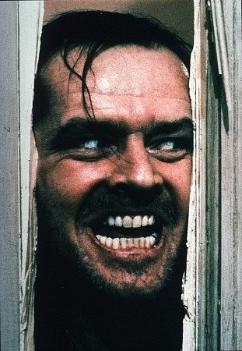
CLOSE UP – the image takes up at least 80 percent of the frame
From the movie “The Shining”

Slide 10
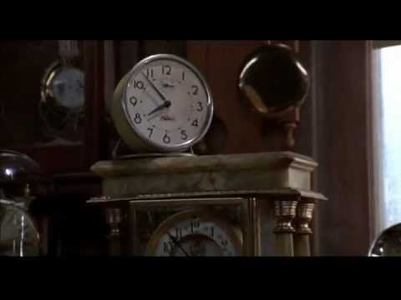

Slide 11
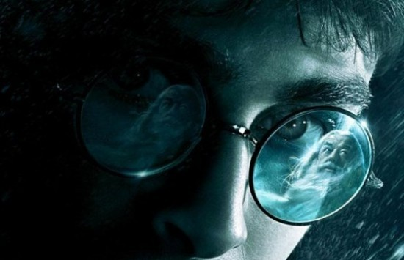
EXTREME CLOSE UP – the image being shot is a part of a whole, such as an eye or a hand

Slide 12
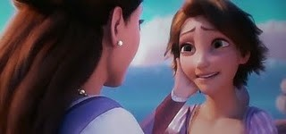
TWO SHOT – a scene between two people shot exclusively from an angle that includes both characters more or less equally. It is used in love scenes where the interaction between two characters is important.
From the movie “Tangled”

Slide 13
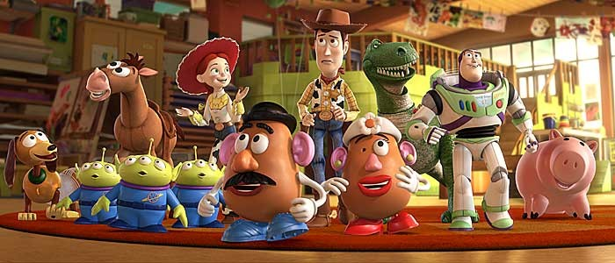
EYE LEVEL – a shot taken from normal height; that is, the character’s eye level. Ninety to ninety-five percent of the shots seen are eye level, because it is the most natural angle.
From the movie “Toys”

Slide 14
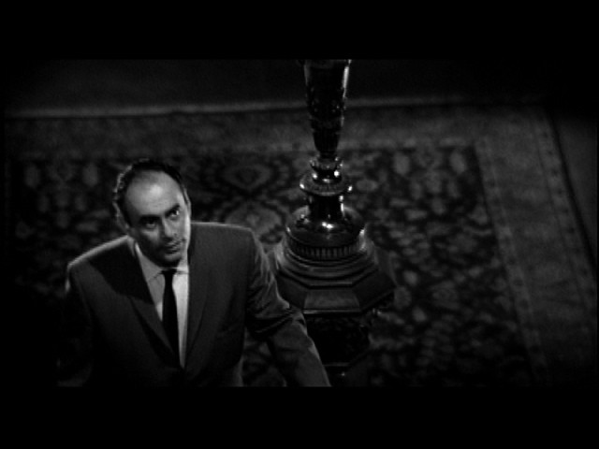
HIGH ANGLE – the camera is above the subject. This usually has the effect of making the subject look smaller than normal, giving him or her the appearance of being weak, powerless or trapped.
From the movie “Psycho”

Slide 15
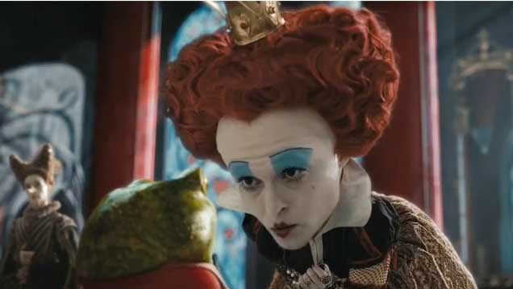
LOW ANGLE – the camera films subject from below. This usually has the effect of making the subject look larger than normal, and therefore strong, powerful, and threatening.
From the movie “Alice in Wonderland”

Slide 16
CAMERA MOVEMENTS
Pan – a stationary camera moves from side to side on a horizontal axis
Tilt – a stationary camera moves up or down along a vertical axis
Zoom – a stationary camera where the lens moves to make an object seems to move closer or further away from the camera. *With this technique, moving into a character is often a personal or revealing movement, while moving away distances or separates the audience from the character.
Dolly/Tracking – the camera is on a track that allows it to move with the action. The term also refers to any camera mounted on a car, truck, or helicopter.
Boom/Crane – the camera is on a crane over the action. This is used to create overhead shots.

Slide 17
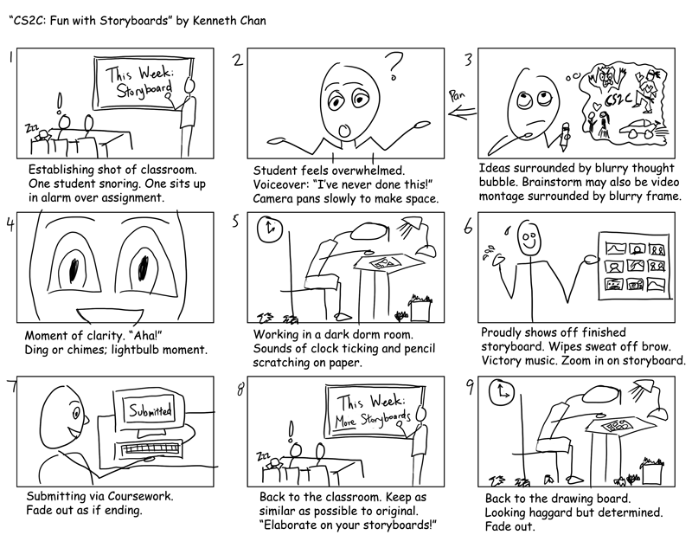
Storyboard sample one (more info page 276)

Slide 18
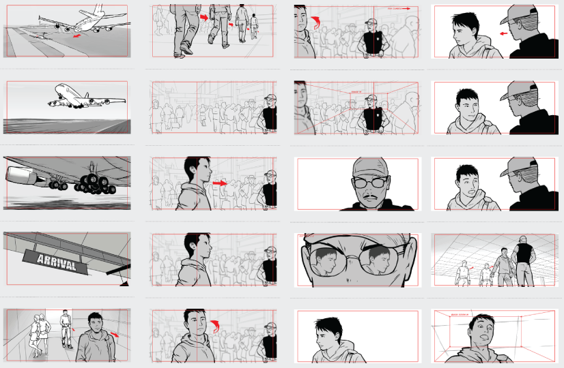
Storyboard Sample 2

Slide 19
Activity: Complete a storyboard for the following scene, using whichever shots and angles you wish.
GIRL is going to school and misses her bus. She begins to walk to school. It starts to rain. The rain intensifies. GIRL takes out her umbrella, but it breaks in the howling wind. She decides to take out her phone to call home, but as she does a car screams past, splashing the contents of a large puddle all over her, causing her to drop her phone. It is broken. GIRL is crestfallen. She continues to walk to school. Then, out of the corner of her eye in the thick rain, she sees somebody cross the street. They pick up their pace as she continues on.

Slide 20
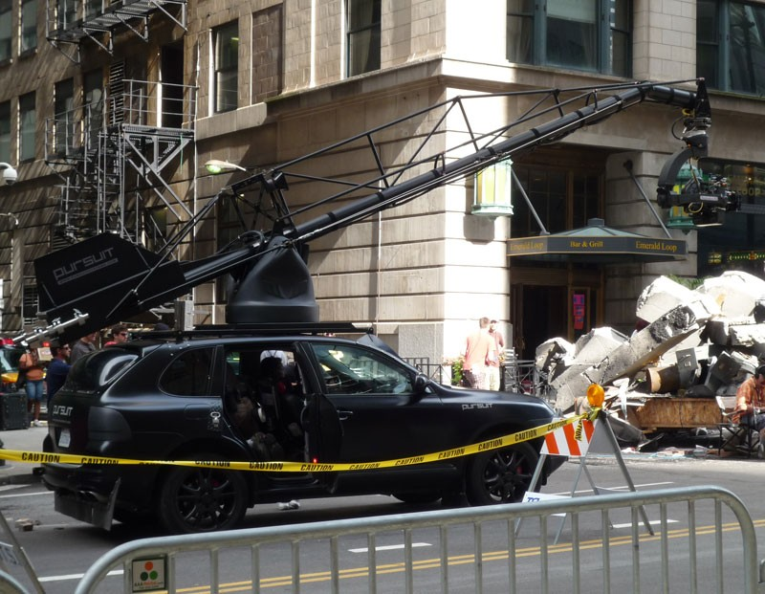
CAMERA MOVEMENTS
Use of Dolly/Tracking and Boom/Crane to shoot “Transformers”

Slide 21
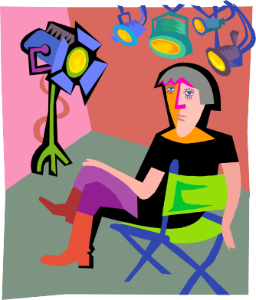
LIGHTING
... how a writer establishes tone and mood in their work
Lighting creates significant emotional responses from the audience based on what people associate with light and darkness
Lighting affects clarity, realism and emotion

Slide 22
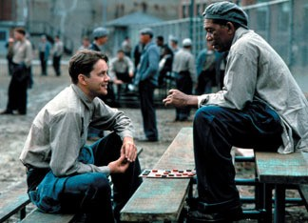
HIGH KEY – the scene is flooded with light; creating a bright and open-looking scene
From the movie “Shawshank Redemption”

Slide 23
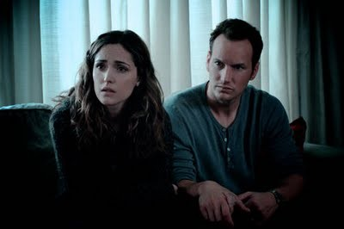
LOW KEY – the scene is flooded with shadows and darkness, creating suspense and suspicion
From the movie “Insidious”

Slide 24
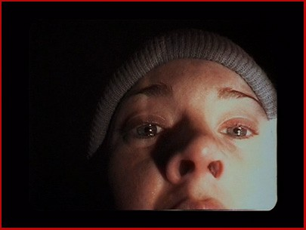
Bottom or Side Lighting – direct lighting from below or the side, which often makes the subject appear dangerous or evil or frightened…
From the movie “The Blair Witch Project”

Slide 25
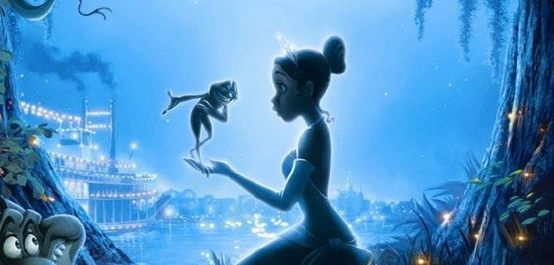
Front or Back Lighting – soft lighting on the actor’s face or from behind which gives the appearance of innocence or goodness, or a halo effect.
From the movie “The Princess and the Frog”

Slide 26
Editing Techniques
Compares to how a writer uses syntax
Cut – two pieces of film are spliced together to “cut” to another image
Fade – can be to or from black and white; implies the passing of time or the end of a scene
Fade-In – darkness to brightness
Fade-Out – image gradually gets darker
Dissolve – a kind of fade in which one image is gradually replaced by another
Wipe – a new image wipes off the previous image (quicker than a dissolve)
Flashback – cut or dissolve to action that happened in the past
Shot-Reverse-Shot – a shot of one subject, then another, than back to the first; often used for conversation or reaction shots
Cross-Cutting – cut into action that is happening simultaneously; creates tension or suspense and creates a connection between scenes
Eye-Line Match – cut to an object, then to a person; can reveal a character’s thoughts

Slide 27
Sound
Compares to how a writer establishes tone and mood in their work
Diegetic – sound that can logically be heard by the characters in the film (dialogue, background noise, sound of things in the scene)
Non-Diegetic – sound that cannot be heard by the characters but is designed for the audience reaction only (ominous music or sounds)

Slide 28
Apply It!
Watch the the clip from Sing Street.
https://www.youtube.com/watch?v=OYxyhXHiae0
Note examples of SHOTS and FRAMING, CAMERA ANGLES, CAMERA MOVEMENTS, LIGHTING, EDITING and MUSIC/SOUND on the Google Doc

